Slide 1
Fundamentals in Artificial Intelligence and Machine Learning
CSA2001

Slide 2
Syllabus
UNIT I - INTRODUCTION
Introduction–Definition - Future of Artificial Intelligence - Characteristics of Intelligent Agents - Typical Intelligent Agents – Problem Solving Approach to Typical AI problems.

Slide 3
UNIT II - PROBLEM SOLVING METHODS
Problem solving Methods - Search Strategies- Uninformed - Informed - Heuristics - Local Search Algorithms and Optimization Problems - Searching with Partial Observations – Constraint Satisfaction Problems – Constraint Propagation - Backtracking Search - Game Playing – Optimal Decisions in Games – Alpha - Beta Pruning - Stochastic Games

Slide 4
UNIT III - KNOWLEDGE REPRESENTATION
First Order Predicate Logic – Prolog Programming – Unification – Forward Chaining-Backward Chaining – Resolution – Knowledge Representation - Ontological Engineering-Categories and Objects – Events - Mental Events and Mental Objects - Reasoning Systems for Categories - Reasoning with Default Information.

Slide 5
UNIT IV - SOFTWARE AGENTS and PROLOG
Architecture for Intelligent Agents – Agent communication – Negotiation and Bargaining – Argumentation among Agents – Trust and Reputation in Multi-agent systems. Facts and predicates, data types, goal finding, backtracking, simple object, compound objects, use of cut and fail predicates, recursion, lists, simple input/output, dynamic database.

Slide 6
UNIT V - INTRODUCTION TO MACHINE LEARNING
Learning – Types of Machine Learning – Supervised Learning – The Brain and the Neuron – Design a Learning System – Perspectives and Issues in Machine Learning – Concept Learning Task – Concept Learning as Search – Finding a Maximally Specific Hypothesis – Version Spaces and the Candidate Elimination Algorithm – Linear Discriminants – Perceptron – Linear Separability – Linear Regression.

Slide 7
Text Books
S. Russell and P. Norvig, Artificial Intelligence: A Modern Approach‖, Prentice Hall, Third Edition, 2009.
Bratko, Prolog: Programming for Artificial Intelligence, Fourth edition, Addison-Wesley Educational Publishers Inc., 2011.
Stephen Marsland, Machine Learning – An algorithmic perspective, Second Edition,
Chapman and Hall/CRC Machine learning and Pattern Recognition Series, 2014.

Slide 8
Basics
A program is a collection of instructions that performs a specific task when executed by a computer.
An algorithm is a process or set of rules to be followed in problem-solving operations, especially by a computer.

Slide 9
Why to study AI?
One reason to study it is to learn more about ourselves
AI strives to build intelligent entities as well as understand them.
These constructed intelligent entities are interesting and useful in their own right.

Slide 10
Artificial intelligence
AI is one of the newest disciplines.
It was formally initiated in 1956.
The study of intelligence is also one of the oldest disciplines.
For over 2000 years, philosophers have tried to understand how seeing, learning, remembering, and reasoning could, or should, be done.
AI currently encompasses a huge variety of subfields- playing chess, proving mathematical theorems, writing poetry, and diagnosing diseases.

Slide 11
AI
What is AI?
Programs that behave externally like humans?
Programs that operate internally as humans do?
Computational systems that behave intelligently?
Rational (logical, reasonable or sensible) behavior?

Slide 12
what is AI?
the automation of activities we associate with human thinking, like decision making, learning ... ?
the art of creating machines that perform functions that require intelligence when performed by people ?
the study of computations that make it possible to perceive, reason and act ?
a branch of computer science that is concerned with the automation of intelligent behaviour ?
anything in Computing Science that we don't yet know how to do properly ? (!)

Slide 13
What is aI?
THOUGHT
Systems that think like humans
Systems that think rationally
BEHAVIOR
Systems that act like humans
Systems that act rationally
HUMAN
RATIONAL

Slide 14
Systems that act like humans
“The art of creating machines that perform functions that require intelligence when performed by people.” (Kurzweil)
“The study of how to make computers do things at which, at the moment, people are better.” (Rich and Knight)

Slide 15
Systems that act like humans
?
You enter a room which has a computer terminal. You have a fixed period of time to type what you want into the terminal, and study the replies. At the other end of the line is either a human being or a computer system.
If it is a computer system, and at the end of the period you cannot reliably determine whether it is a system or a human, then the system is deemed to be intelligent.

Slide 16
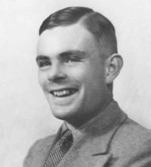
Turing Test (1950)
Turing defined intelligent behavior as the ability to achieve human-level performance in all cognitive tasks, sufficient to fool an interrogator.
The Turing Test approach
A human questioner cannot tell if
There is a computer or a human answering his question, via teletype (remote communication)
The computer must behave intelligently
Alan Turing

Slide 17
Systems that act like humans
These cognitive tasks include:
Natural language processing
to enable it to communicate successfully in English.
Knowledge representation
to store information provided before or during the interrogation
Automated reasoning
to retrieve & answer questions using the stored information
Machine learning
to adapt to new circumstances and to detect and extrapolate patterns.

Slide 18
Total turing test
Turing's test deliberately avoided direct physical interaction between the interrogator and the computer, because physical simulation of a person is unnecessary for intelligence.
Total Turing Test includes a video signal so that the interrogator can test the subject's perceptual abilities, as well as the opportunity for the interrogator to pass physical objects "through the hatch."
To pass the total Turing Test, the computer will need
computer vision to perceive objects, and
robotics to move them about.

Slide 19
Systems that think like humans: cognitive modeling
Humans as observed from ‘inside’
How do we know how humans think?
There are two ways to do this:
through introspection—trying to catch our own thoughts as they go by
through psychological experiments.
Once we have a sufficiently precise theory of the mind, it becomes possible to express the theory as a computer program.
If the program's input/output and timing behavior matches human behavior, that is evidence that some of the program's mechanisms may also be operating in humans.

Slide 20
Cognitive Science
“The exciting new effort to make computers think … machines with minds in the full and literal sense” (Haugeland)
“[The automation of] activities that we associate with human thinking, activities such as decision-making, problem solving, learning …” (Bellman)

Slide 21
Systems that think ‘rationally’
Greek philosopher - Aristotle was one of the first to attempt to codify "right thinking,"
Humans are not always ‘rational’
Rational - defined in terms of logic?
Logic can’t express everything (e.g. uncertainty)
For example, "Socrates is a man; all men are mortal; therefore Socrates is mortal."
Logical approach is often not feasible in terms of computation time (needs ‘guidance’)
Notes:
Syllogisms - an instance of a form of reasoning in which a conclusion is drawn from two given or assumed propositions (premises);

Slide 22
"laws of thought"
“The study of mental facilities through the use of computational models” (Charniak and McDermott)
“The study of the computations that make it possible to perceive, reason, and act” (Winston)

Slide 23
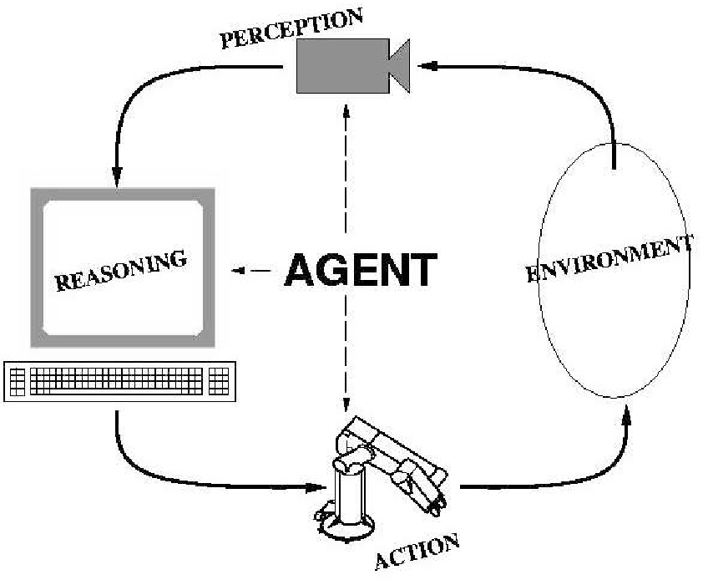
Systems that act rationally: “Rational agent”
A rational agent can be anything that makes decisions, typically a person, firm, machine, or software.
Rational behavior: doing the right thing
The right thing: that which is expected to maximize goal achievement, given the available information

Slide 24
Rational agents
An agent is an entity that perceives and acts
Abstractly, an agent is a function from percept histories to actions:
[f: P* → A]
For any given class of environments and tasks, we seek the agent (or class of agents) with the best performance
Warning: computational limitations make perfect rationality unachievable
→ design best program for given machine resources

Slide 25
Artificial
Produced by human art or effort, rather than originating naturally.
Intelligence – “is the ability to acquire knowledge and use it" [Pigford and Baur]
So AI was defined as:
AI is the study of ideas that enable computers to be intelligent.
AI is the part of computer science concerned with design of computer systems that exhibit human intelligence (From the Concise Oxford Dictionary)

Slide 26
From the above two definitions, we can see that AI has two major roles:
Study the intelligent part concerned with humans.
Represent those actions using computers.

Slide 27
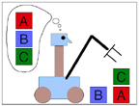
Goals of AI
To make computers more useful by letting them take over dangerous or tedious tasks from human.
Understand principles of human intelligence

